Slide 1
Animal2Animal Style Transfer with CycleGANs
Final Capstone by
Weston Scott

Slide 2

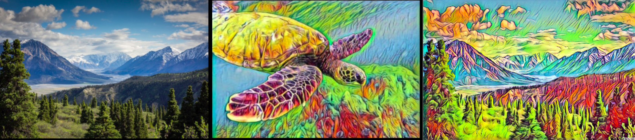


INTRODUCTION
Hello, my name is Weston Scott
Mathematics: Probability and Statistics
Senior Analyst at Digital Addix
My Project
Style Transfer
Generative Adversarial Networks
TensorFlow and Google Cloud GPUs

Slide 3
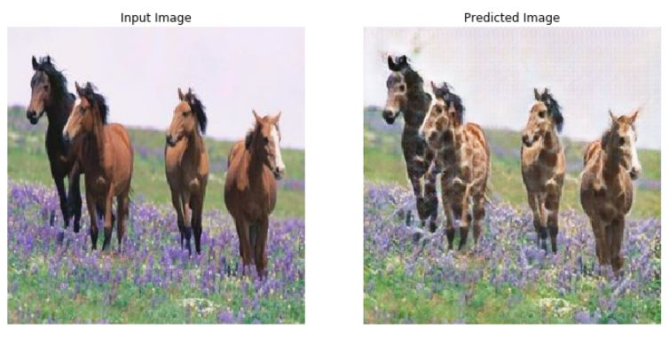
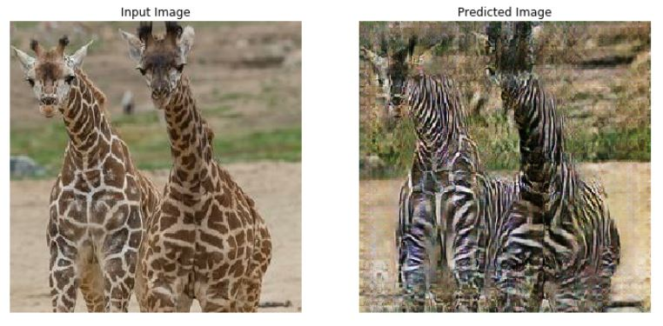
ANIMAL STYLE TRANSFER
Base Image
Style

Slide 4
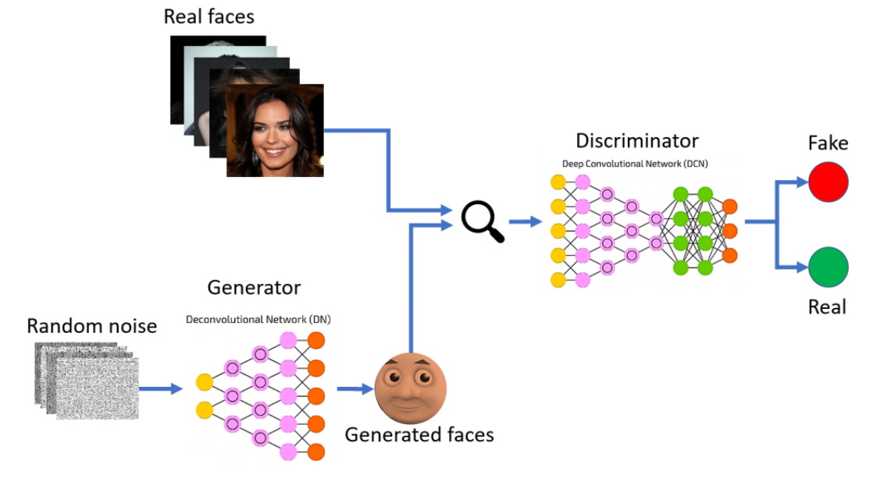
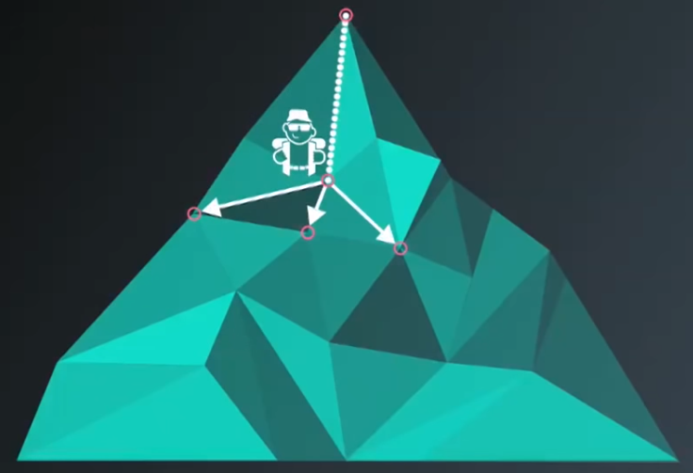
KEY TOPICS
Neural Networks
Deep Learning
Image Processing and Generation
Gradients
For each training step, we are evaluated based on set loss functions
Our optimizers will take steps towards a gradient to lower the loss function over time
Optimizer
Stochastic Gradient Descent
Adam Optimizer

Slide 5
GENERATIVE ADVERSARIAL NETWORKS
Discriminator
The purpose of this function is to determine the difference between a real and a fake image
For example, if we were determining the difference between a giraffe and a “giraffe” generated from a horse image, our model may learn that the giraffe pattern is consistent across the real giraffe image but not the generated image
Generator
At first, this function might add random noise to the training image
Over each training step, it determines which characteristics the discriminator has learned to tell the difference between a real and fake image and applies those characteristics to its image
Adversarial Nature
These functions are in a constant adversarial battle with one another to minimize their respective loss functions

Slide 6


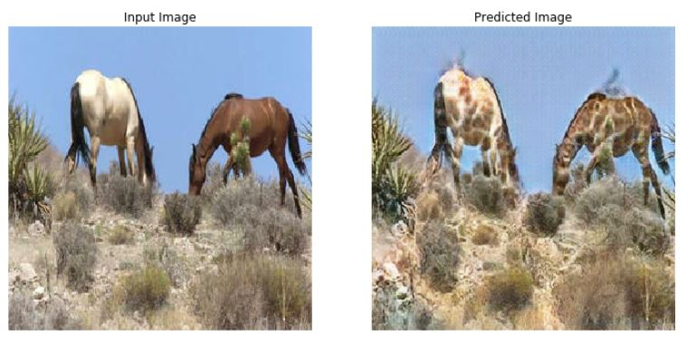
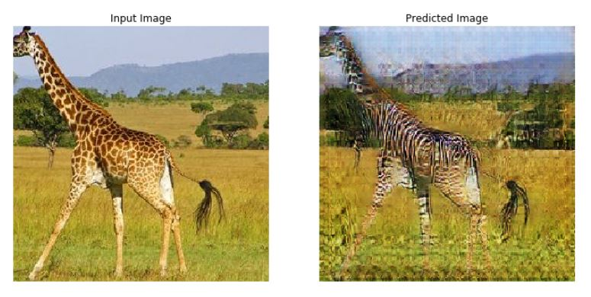
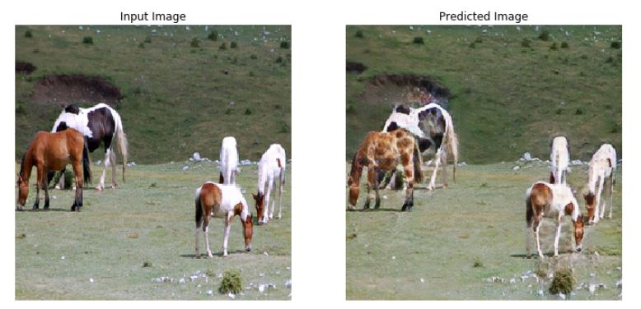
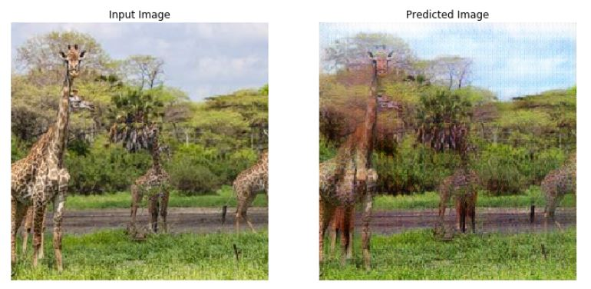
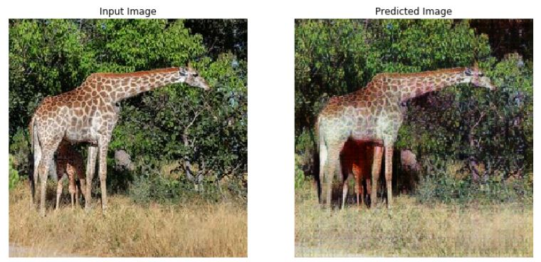
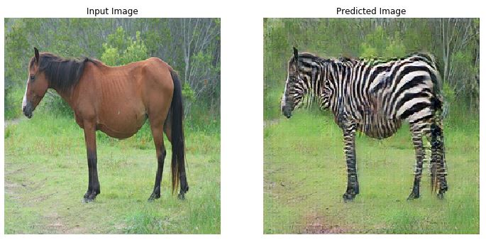
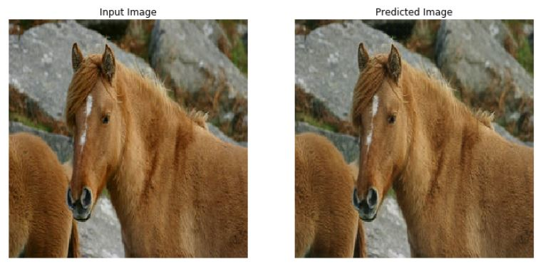
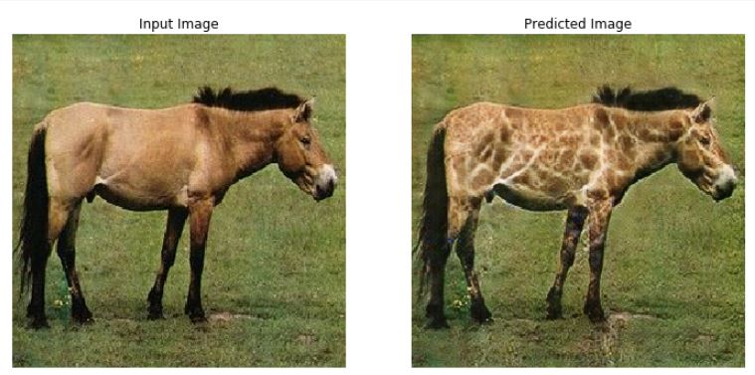
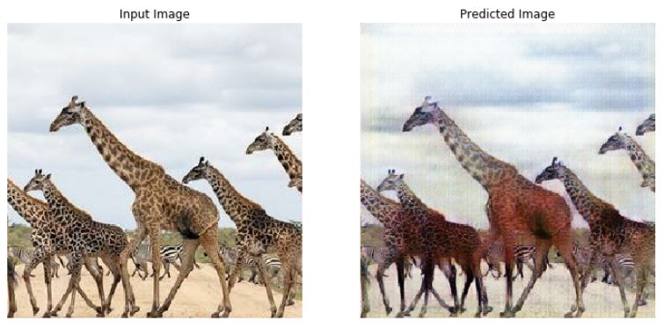
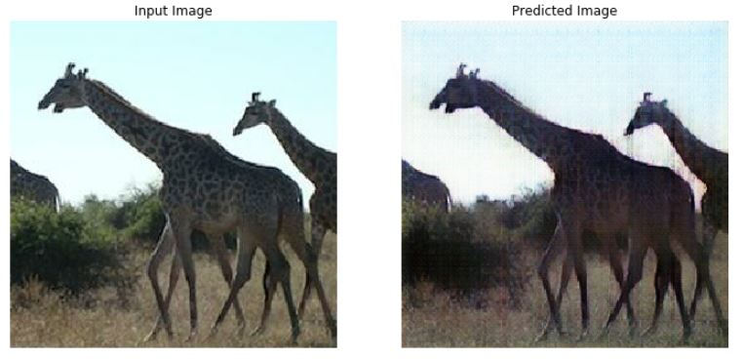
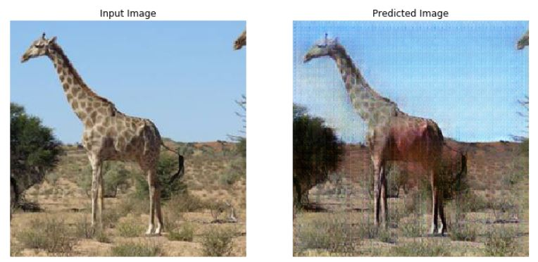
DATA PIPELINE
For the model to learn the nuances of each domain for translation, it requires a collection of images from both animals for training
Collection of
Horse Images
Collection of
Giraffe Images
600
Training Images
. . .
. . .
600
Training Images

Slide 7
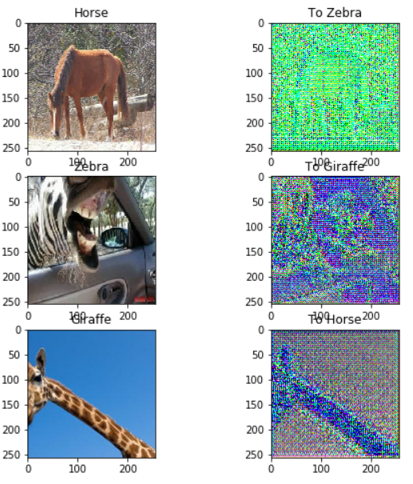
GENERATOR
Input
Images
Output
Images
Generators G(x) and F(y)
Trained to take input images x and y
We’ll consider horse images as x and giraffe images as y
Based on current node weights, the functions will output our base image in the style of the opposing domain
For example, the horse and giraffe domains will have a horse to giraffe generator G(x) and a giraffe to horse generator F(y) such that:
G(x) = y
F(y) = x

Slide 8

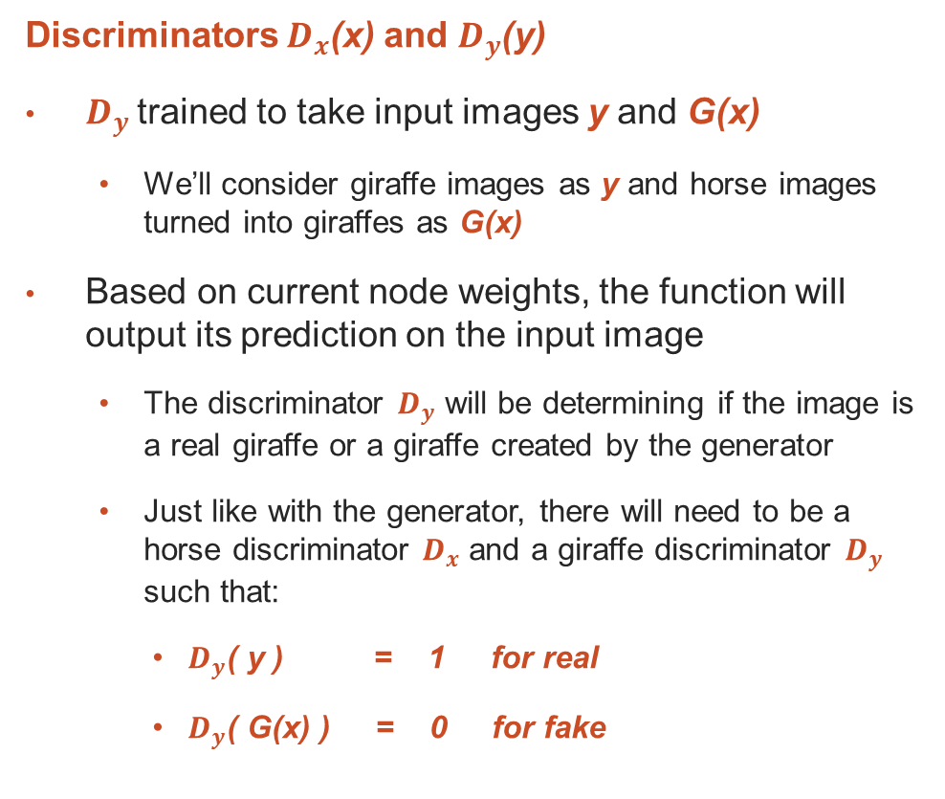
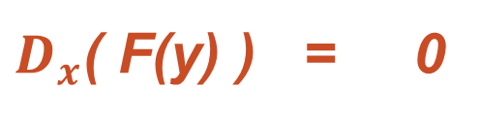
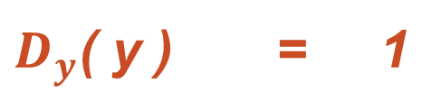
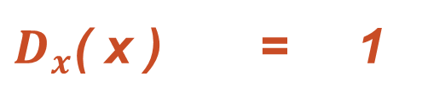
DISCRIMINATOR
Input Images
Discriminators $D_{x}$(x) and $D_{y}$(y)
$D_{y}$trained to take input images y and G(x)
We’ll consider giraffe images as y and horse images turned into giraffes as G(x)
Based on current node weights, the function will output its prediction on the input image
The discriminator $D_{y}$ will be determining if the image is a real giraffe or a giraffe created by the generator
Just like with the generator, there will need to be a horse discriminator $D_{x}$ and a giraffe discriminator $D_{y}$ such that:
$D_{y}$( y ) = 1 for real
$D_{y}$( G(x) ) = 0 for fake
$D_{x}$( x ) = 1
$D_{x}$( F(y) ) = 0
$D_{y}$( y ) = 1
$D_{y}$( G(x) ) = 0

Slide 9
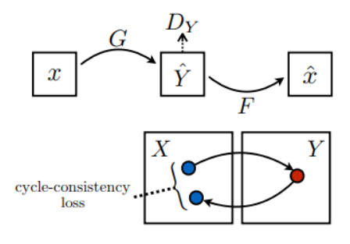
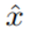
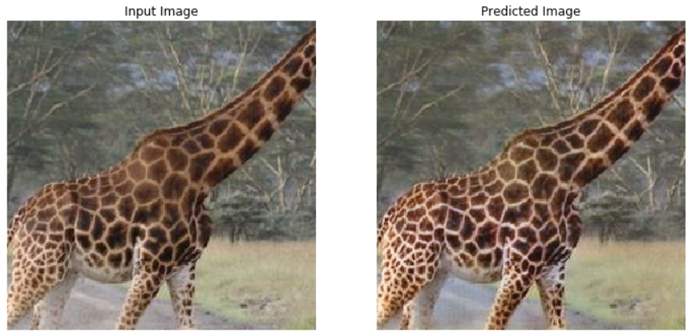
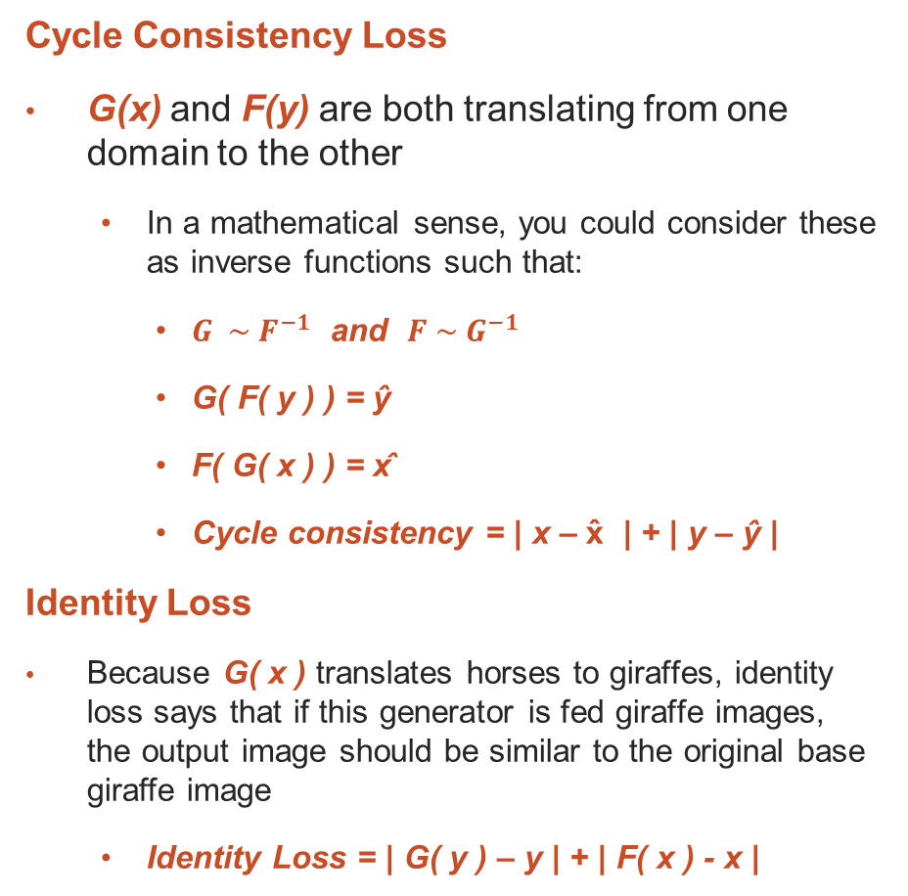
LOSS FUNCTIONS
Cycle Consistency Loss
G(x) and F(y) are both translating from one domain to the other
In a mathematical sense, you could consider these as inverse functions such that:
${G \sim F}^{−1}$ and ${F \sim G}^{−1}$
G( F( y ) ) = ŷ
F( G( x ) ) = x̂
Cycle consistency = | x – x̂ | + | y – ŷ |
Identity Loss
Because G( x ) translates horses to giraffes, identity loss says that if this generator is fed giraffe images, the output image should be similar to the original base giraffe image
Identity Loss = | G( y ) – y | + | F( x ) - x |
G( y )

Slide 10
TRAINING PROCESS
Input images in generator
40x (Epochs)
Test images against discriminator
Evaluate loss functions
Apply gradients

Slide 11
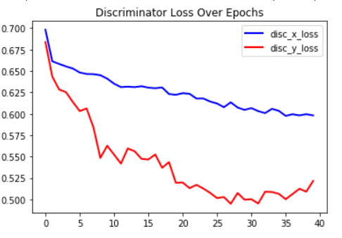
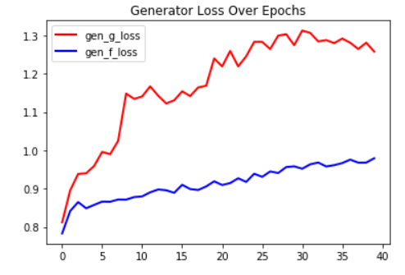
LOSS FUNCTION RESULTS
Overall, the biggest thing to note is the progressive increase in the performance of the discriminator. Additionally, you’ll notice the mirrored aspect of the discriminator, a given by-product of the adversarial nature of the networks.
Discriminator Over Time
Generator Over Time

Slide 12
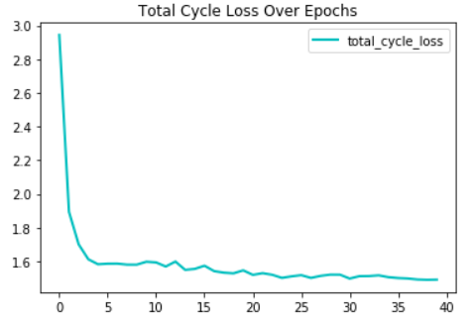
LOSS FUNCTION RESULTS
Cycle Loss Over Time
As you can see there was a stark decrease in cycle loss
In a future iteration, we’ll want to lower the learning rate even further
We’ll also want to run our model for more epochs until the learning rate completely flattens out
With 3 separate modelling pairs and each model taking over 10 hours to train, running multiple iterations and increasing epochs was not within a reasonable timeline

Slide 13
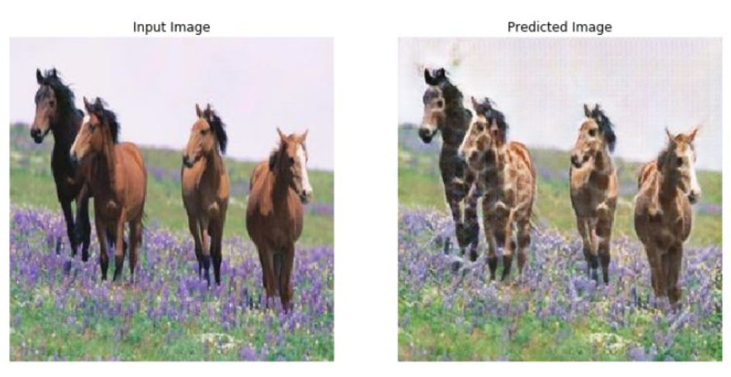
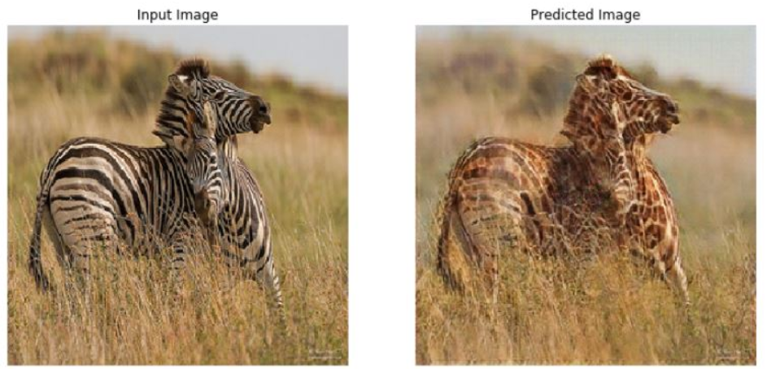
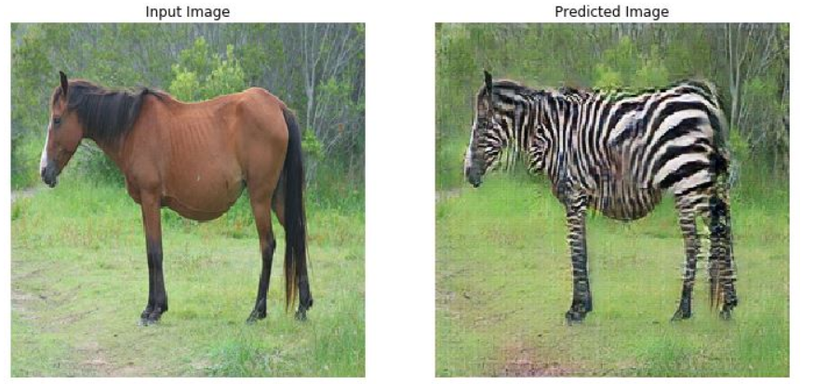
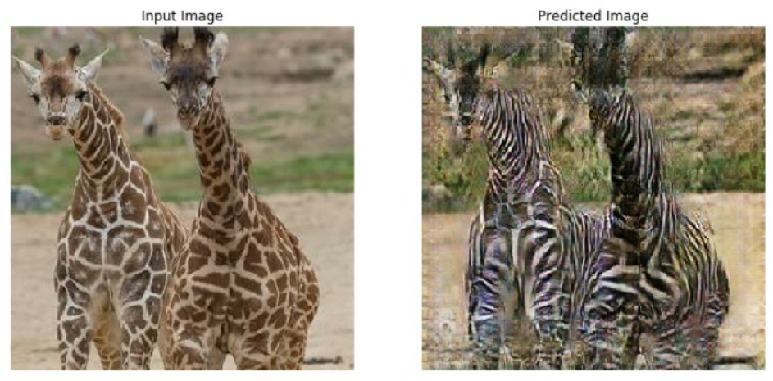
GENERATOR RESULTS
Our models did an excellent job transferring the style of zebras and giraffes to the horse domain. This is likely due to our model’s ability to identify the horse object. The same case goes for our model’s ability to recognize the consistent patterns of the zebra and giraffe.

Slide 14
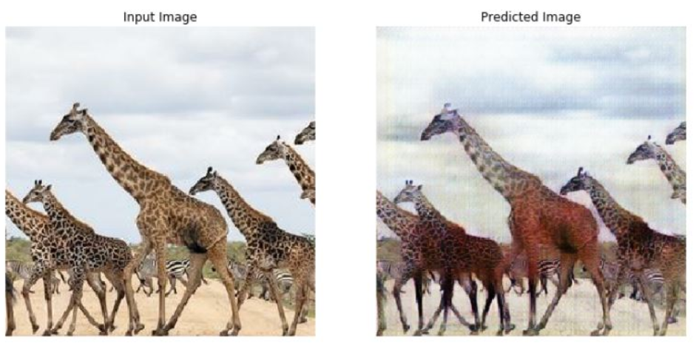
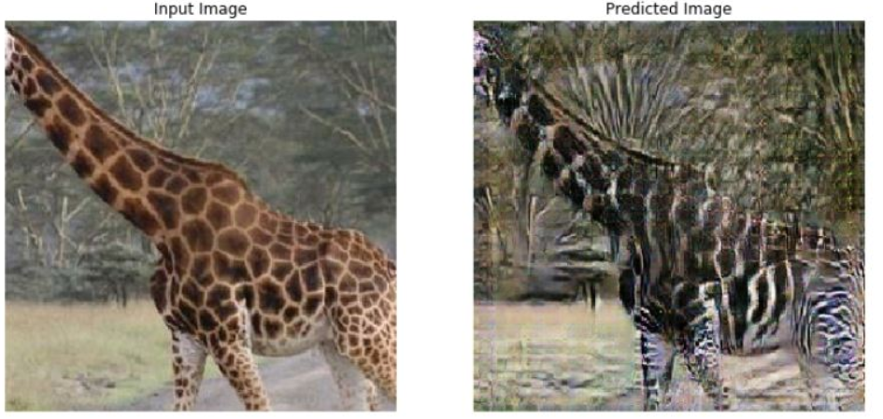
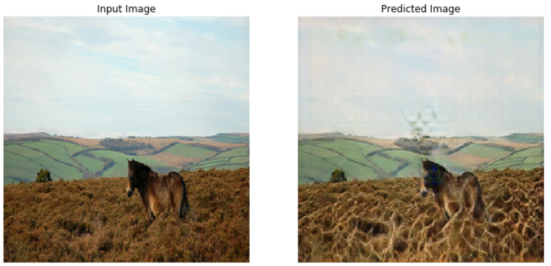
SHORTCOMINGS
When transferring both horse and zebra, the model had a difficult time dealing with the giraffe’s long neck, as this is not a feature of either a horse or a zebra. In most cases the model could transfer some of the style to the body of the giraffe but was generally unsuccessful transferring to anything above the neck or below the knees.

Slide 15
IMPROVEMENTS
Computational resources
Each model took roughly 10 hours to run on Google Cloud GPUs
Greater GPU resources could allow for more epochs and better results over time
Additional object detection layers
With the issues regarding neck detection, adding layers to identify the neck would yield better results for giraffe domain translation
Potentially using sequential generators for the neck, then the legs, then the body
More Images
Though I was able to pipe in 600 images for the training process, a collection of over 1,000 images would likely allow for better results on test images

Slide 16
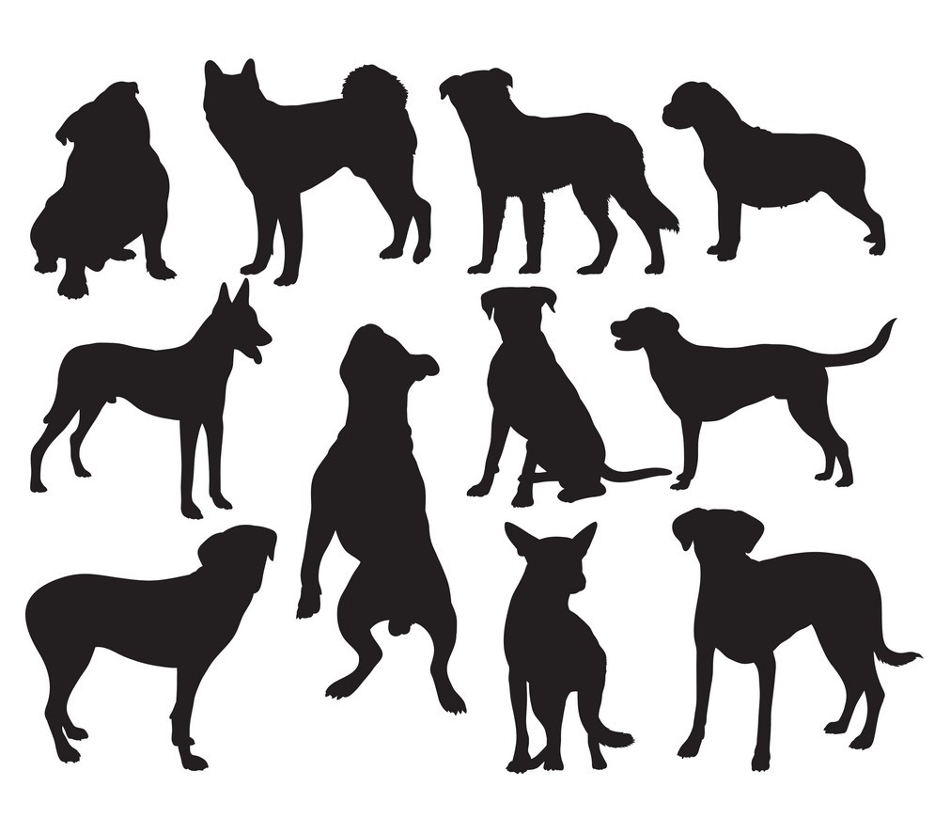
FUTURE RESEARCH
Now that I have general process for Animal2Animal style transfer, it would be interesting to see how this model does as we diverge into various species
Stay tuned for a Dog2Dog style transfer sometime in the near future!

Slide 17
THANK YOU

